Slide 1
Brute Force Approach and Exhaustive Search

Slide 2
Brute Force Approach
The Brute force Algorithm is the first approach that comes to our mind upon seeing the problem. It's a method of solving a problem by iterating through all possible solutions, which can be an incredibly time-consuming process. However, the Brute force Algorithm is also highly effective in finding solutions that other algorithms might miss.
In essence, the Brute force Algorithm is all about trial and error, letting a computer work systematically through a range of possibilities until it arrives at the correct solution. Although this process may take longer than other algorithms, it can be very rewarding once you see the results.

Slide 3
Outline of Brute Force Approach
Define the problem: Clearly understand the problem you are trying to solve and the constraints involved.
Enumerate all possible solutions: Generate or iterate through all possible candidates for the solution. The number of candidates typically depends on the size of the problem and the constraints involved.
Test each candidate: For each candidate solution, apply the problem constraints and evaluate whether it satisfies the required conditions.
Select the correct solution: If a candidate solution satisfies all the required conditions, it is considered the correct solution. If multiple solutions are possible, you can choose the best one based on specific criteria.
Analyze the time complexity: Brute force algorithms often have a high time complexity, especially when dealing with large problem spaces. It is important to analyze the efficiency of the algorithm and consider optimization techniques if necessary.

Slide 4
Types of Brute Force Algorithm
Optimizing: In this case, the best solution is found. To find the best solution, it may either find all the possible solutions to find the best solution or if the value of the best solution is known, it stops finding when the best solution is found. For example: Finding the best path for the traveling salesman problem. Here the best path means that traveling all the cities and the cost of travelling should be minimal.
Satisficing: It stops finding the solution as soon as the satisfactory solution is found. For example, finding the traveling salesman path within 10% of optimal.

Slide 5
Advantages of Brute Force Approach
Simplicity: Brute force algorithms are usually easy to understand and implement. They involve basic looping and iteration constructs, making them accessible even to novice programmers.
Correctness: By systematically considering all possible solutions, a brute force algorithm guarantees to find the optimal solution, if one exists. It exhaustively checks all possibilities, leaving no room for overlooking potential solutions.
Reliability: Brute force algorithms are highly reliable due to their exhaustive nature. They are not influenced by specific data distributions or assumptions, as they evaluate every possible solution.
Versatility: Brute force algorithms can be applied to various problem domains. They do not require any specific problem-specific knowledge or heuristics, making them applicable in various contexts. Additionally, they can be used as a benchmark to evaluate the effectiveness of more sophisticated algorithms, providing a baseline for comparison

Slide 6
Disadvantage of Brute Force Approach
Time Complexity: Brute-force algorithms typically have a high time complexity, especially for large problem sizes. They explore all possible solutions exhaustively, which can result in an exponential number of iterations. As a result, the execution time can quickly become unmanageable or even infeasible for complex problems.
Inefficiency: Brute-force algorithms often evaluate many irrelevant or redundant solutions before finding the correct one.
Memory Usage: Some brute-force algorithms require storing a large amount of data in memory, which can be problematic for memory-constrained systems or when dealing with massive data sets.
Lack of Scalability: Brute-force algorithms are generally not scalable, meaning that they struggle to handle larger problem instances.
Suboptimal Solutions: Brute-force algorithms explore all possible solutions, including those that are suboptimal. This exhaustive search approach may not be necessary in many cases, as there may be more efficient algorithms or techniques available to solve the problem. Consequently, brute-force algorithms may not provide the most optimal solution within a reasonable timeframe.
Dependency on Problem Structure: The effectiveness of brute-force algorithms heavily relies on the structure of the problem. If the problem has inherent patterns or symmetries that can be exploited, more efficient algorithms specifically designed for that problem may exist. Brute-force approaches often overlook these structural properties, leading to unnecessarily long computation times.
Lack of Adaptability: Brute-force algorithms are typically rigid and inflexible. They follow a fixed pattern of exploring all possible solutions without adapting to the characteristics of the problem or leveraging any problem-specific knowledge.

Slide 7
Exhaustive Search
Exhaustive Search is a brute-force algorithm that systematically enumerates all possible solutions to a problem and checks each one to see if it is a valid solution. This algorithm is typically used for problems that have a small and well-defined search space, where it is feasible to check all possible solutions.

Slide 8
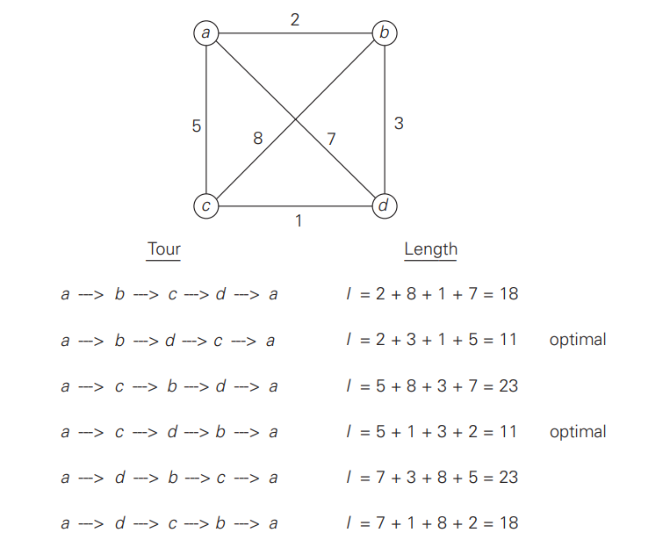
Travelling Salesman Problem
Consider city 1 as the starting and ending point. Since the route is cyclic, we can consider any point as a starting point.
Generate all (n-1)! permutations of cities.
Calculate the cost of every permutation and keep track of the minimum cost permutation.
Return the permutation with minimum cost.
Time complexity: O(n!) where n is the number of vertices in the graph. This is because the algorithm uses the next_permutation function which generates all the possible permutations of the vertex set. Auxiliary Space: O(n) as we are using a vector to store all the vertices.

Slide 9

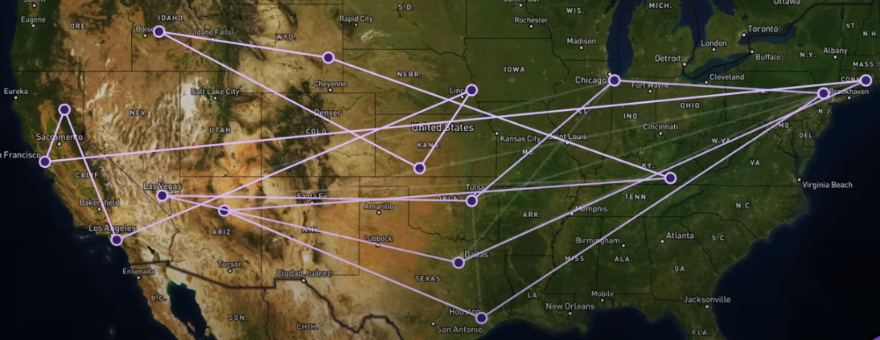
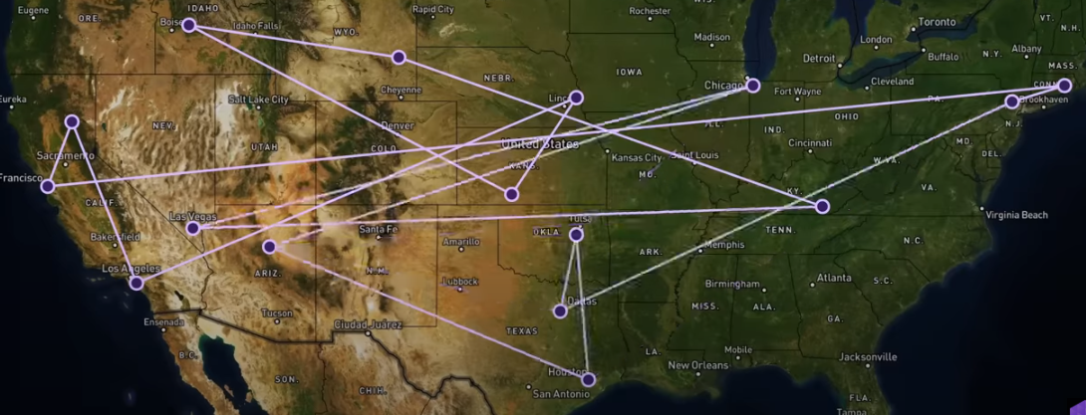
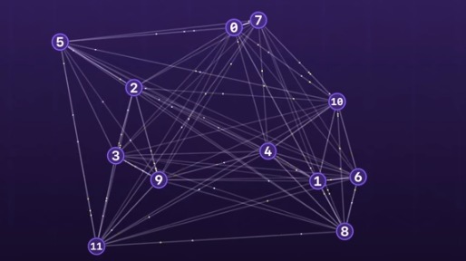
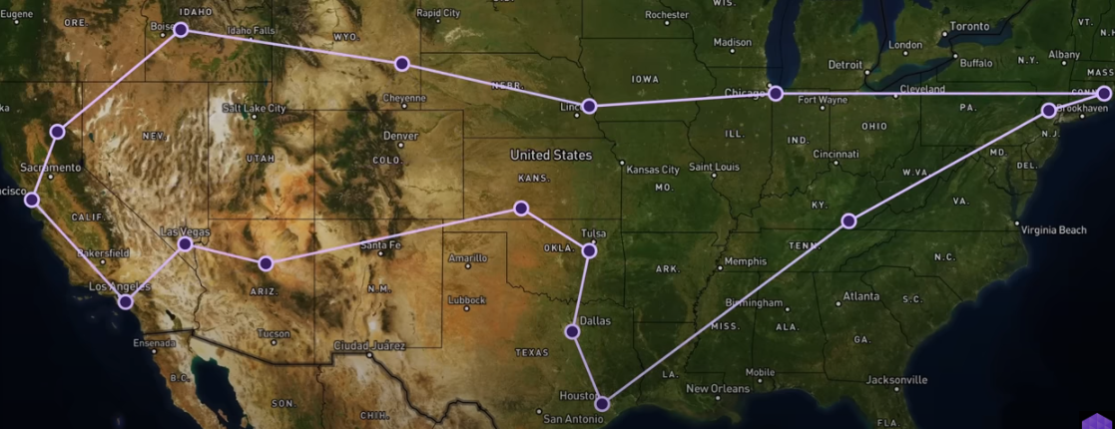
Travelling Salesman Problem

Slide 10
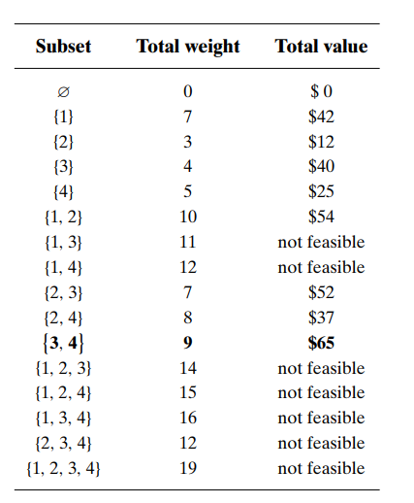
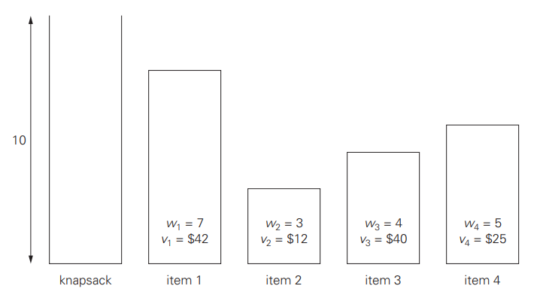
Knapsack Problem

Slide 11
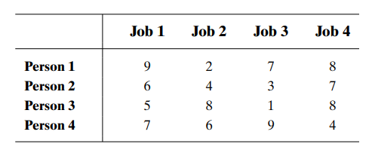
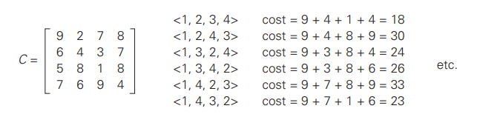
Assignment Problem

Slide 12
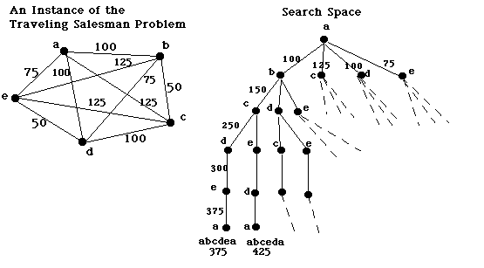
State Space Search for TSP

Slide 13
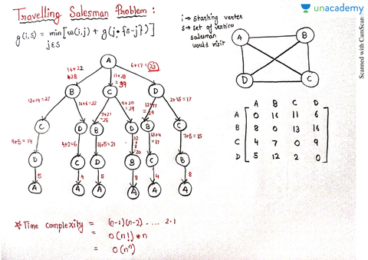
Example of State Space Search for TSP

Slide 14
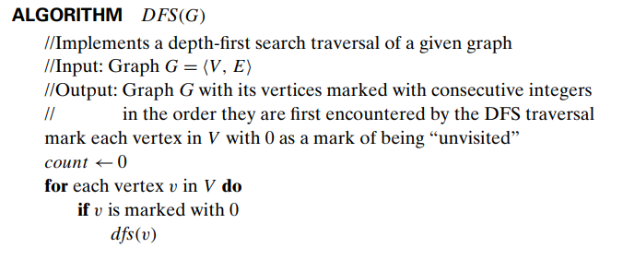
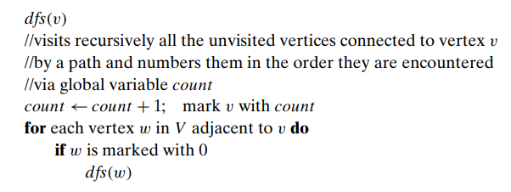
Depth First Search

Slide 15
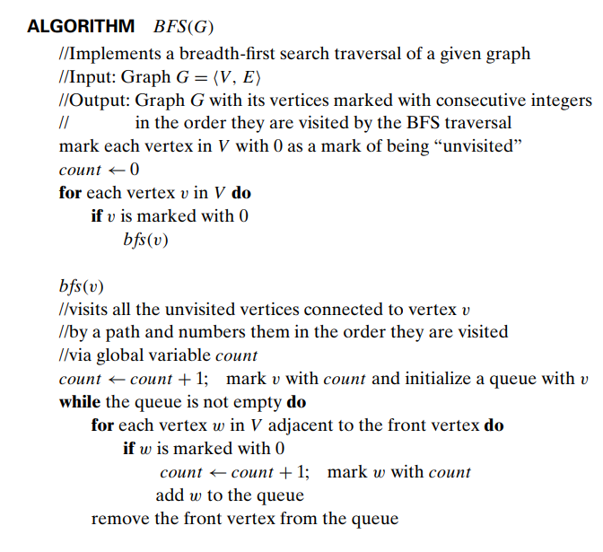
Breadth First Search

Slide 16
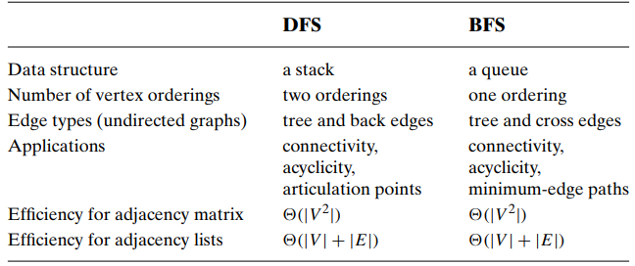
Comparison between DFS and BFS

Slide 17
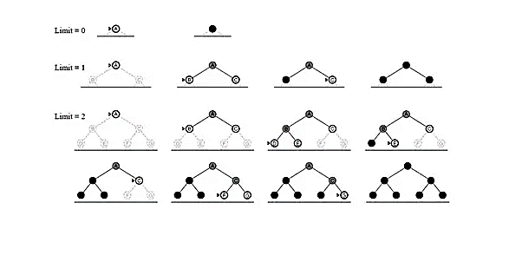
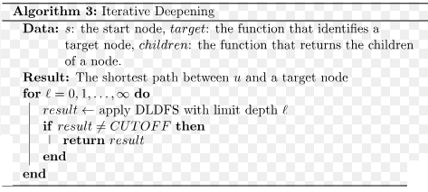
Iterative Deepening Search

Slide 18
References
Brute Force Algorithm in Data Structures: Types, Advantages, Disadvantages (scholarhat.com)
The Traveling Salesman Problem: When Good Enough Beats Perfect – YouTube
Basic AI Algorithms. Search Algorithms for Traveling… | by Mengsay Loem | Towards Data Science

